Slide 1
VOCATIONAL VOCABULARY
IA Y1 P1
"An interior is the natural projection of the soul" - Coco Chanel
During this period, you will learn the basic terms and vocabulary, needed for your profession.
The better you are able to describe, the closer you will get to the ‘soul’ of the design.
VOCAB TEST = WEEK 8 (last week of October)

Slide 2
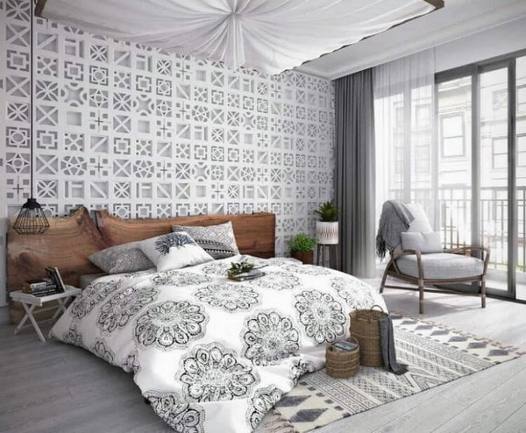
I will not provide a word list.
You will need to write down the Dutch translations yourself.
You can find this Powerpoint and all other materials on Teams.

Slide 3
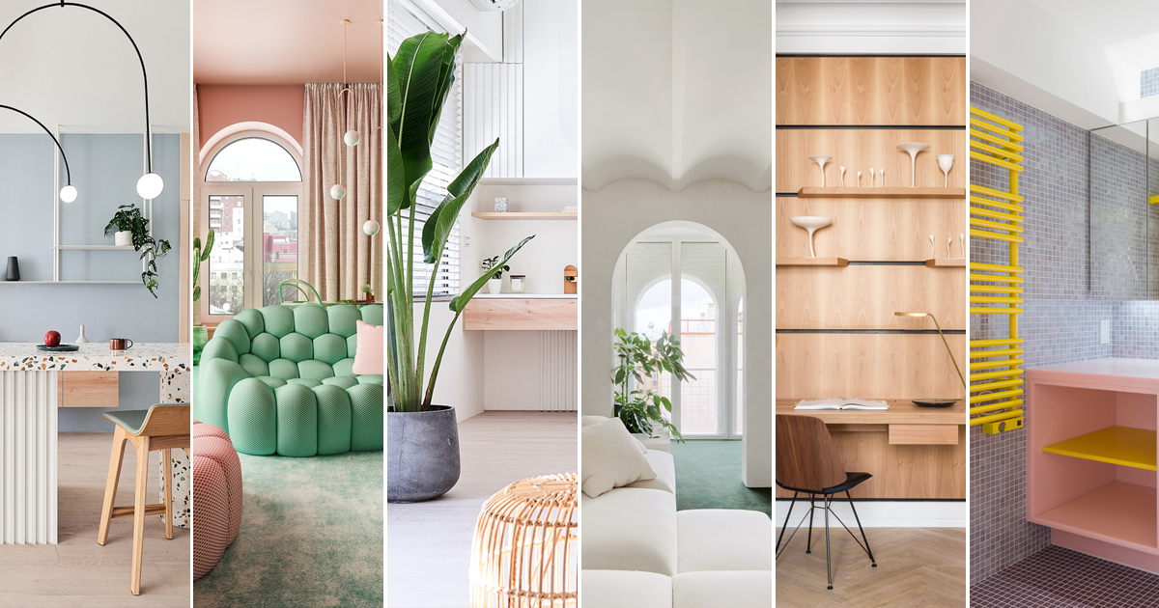
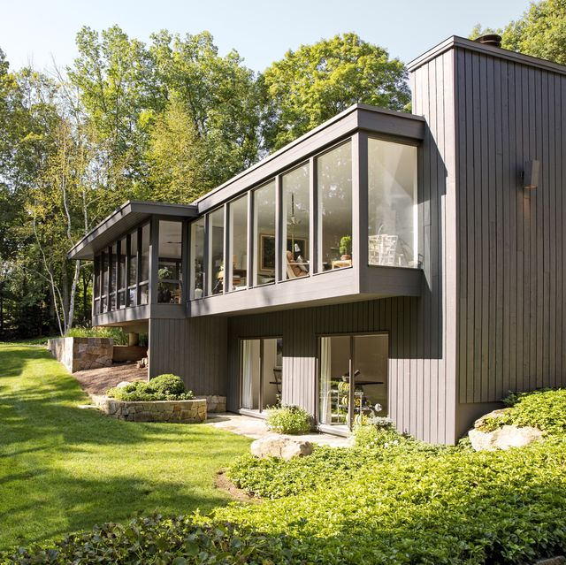
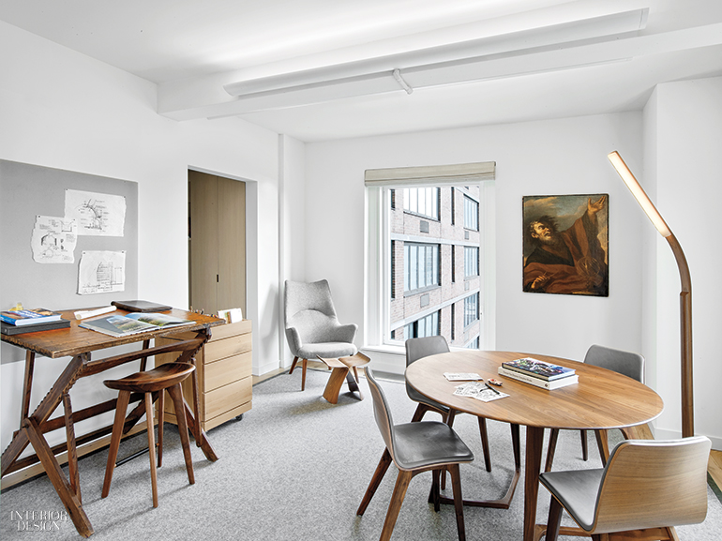
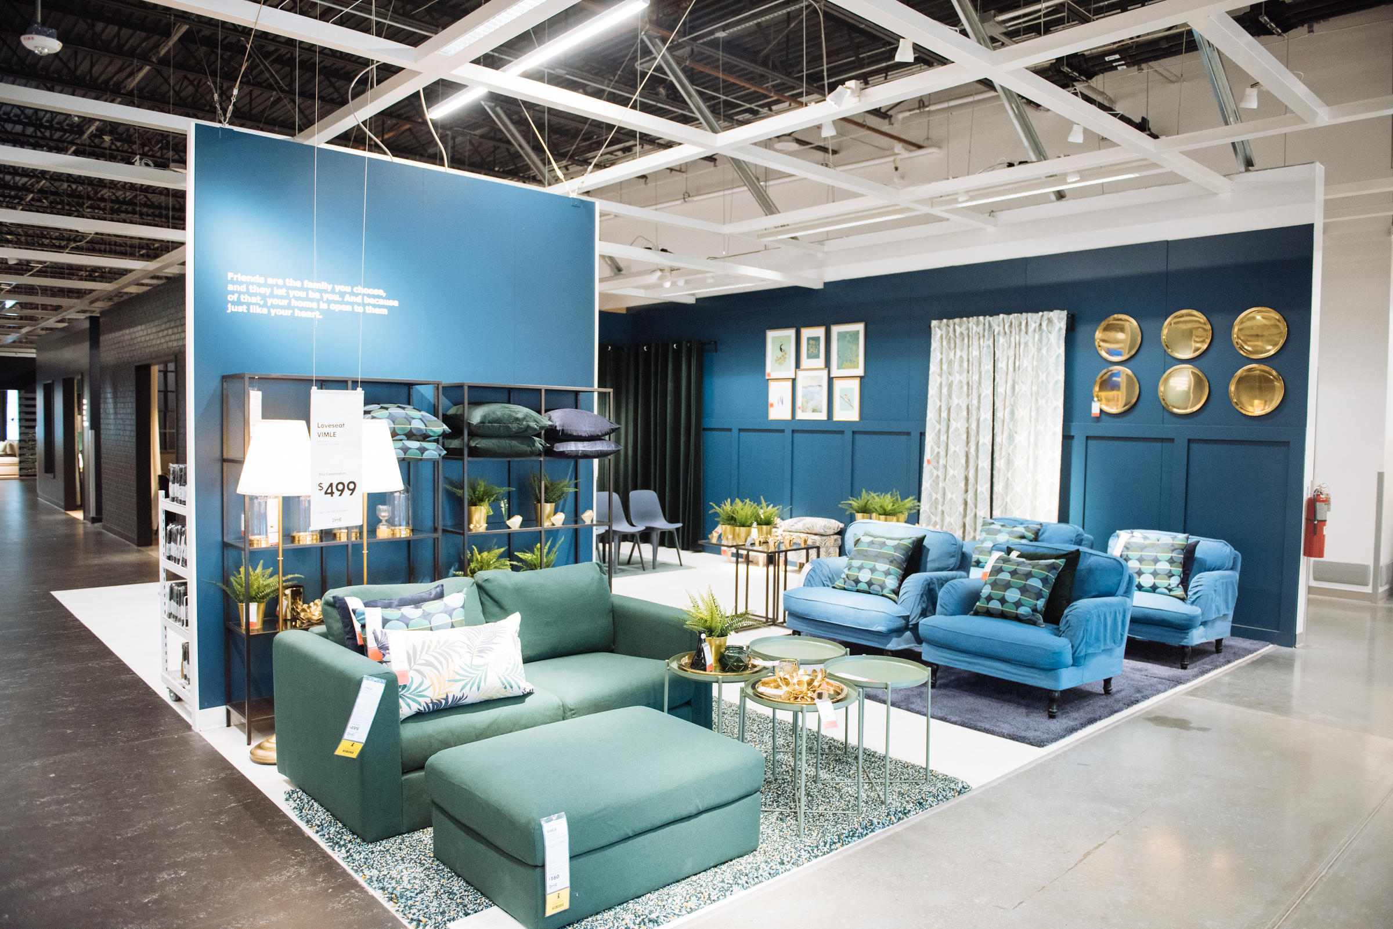
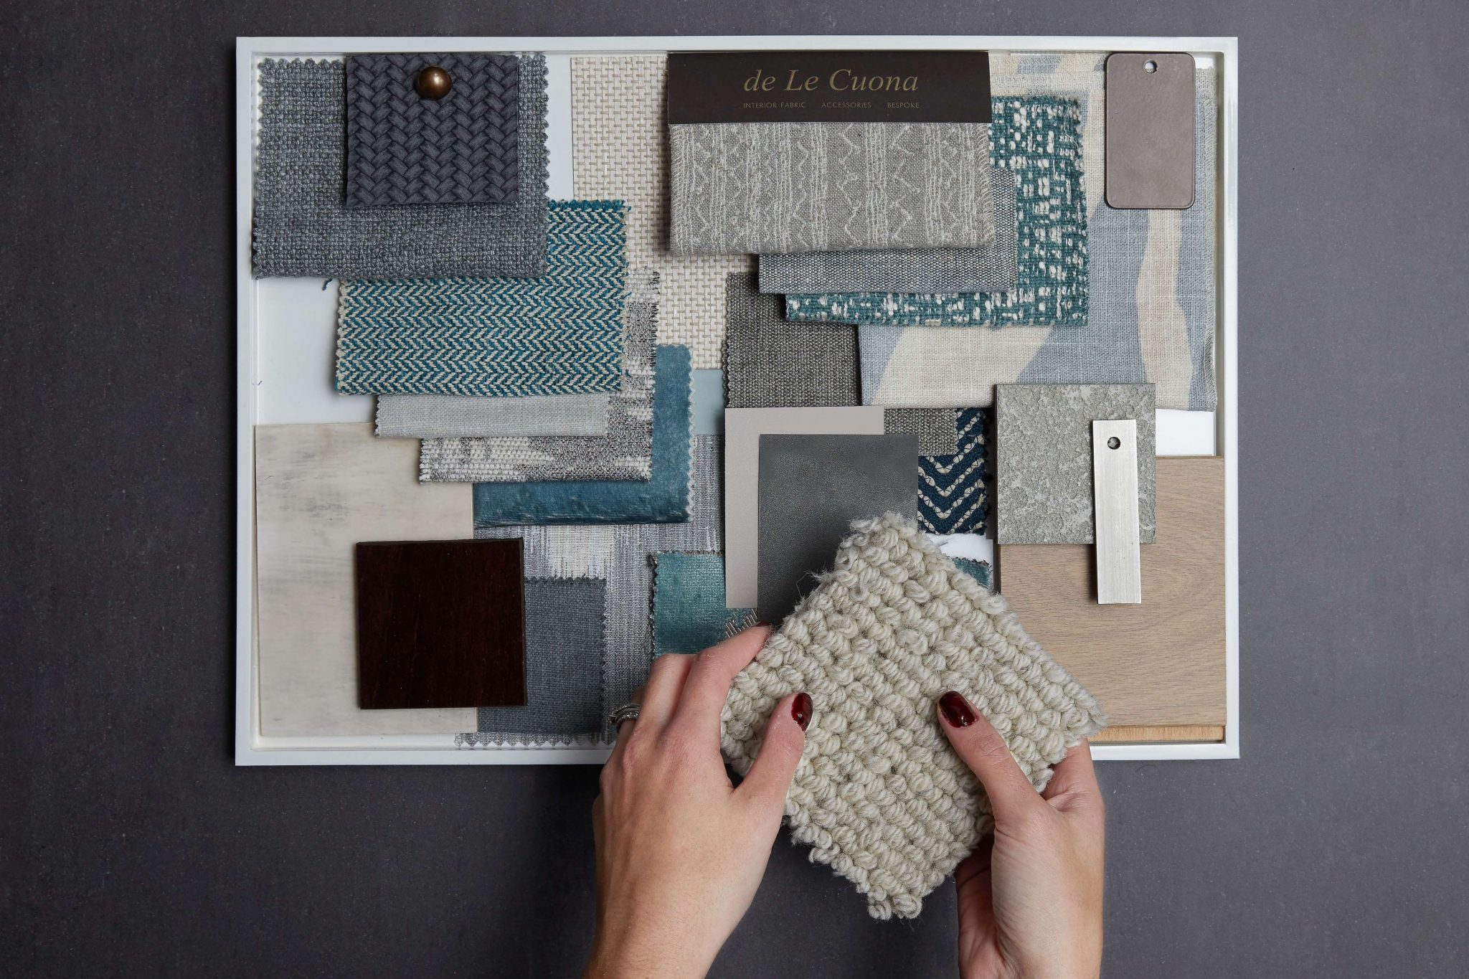
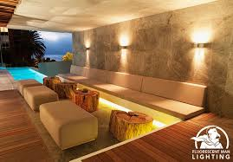
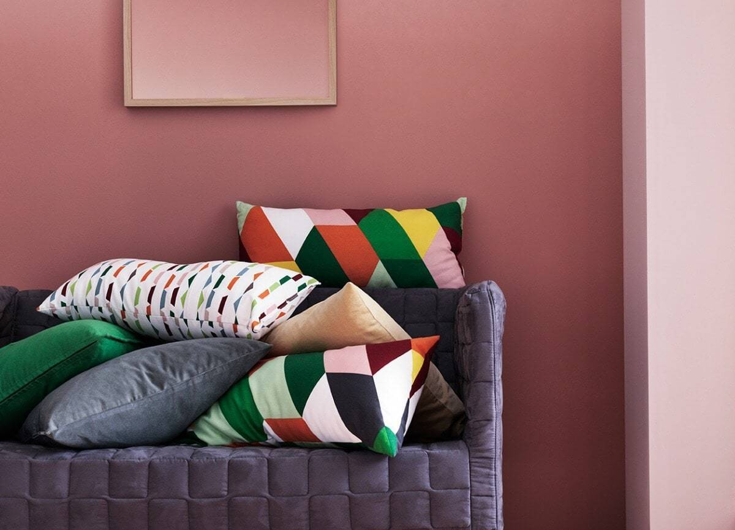
interior
exterior
spaces
fabrics
mood/ ambiance
lighting
furniture
CAN YOU THINK OF OTHER WORDS TO DESCRIBE THE MOOD OF A ROOM?
cushions

Slide 4
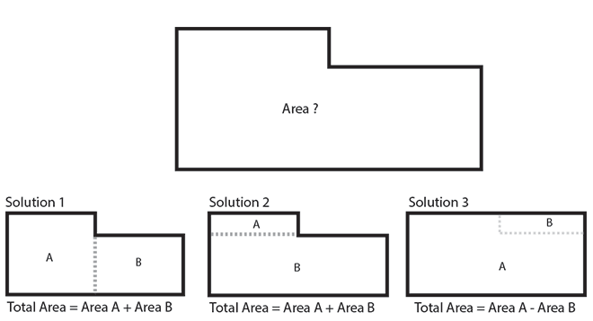
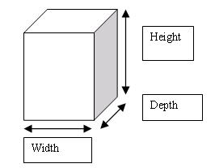
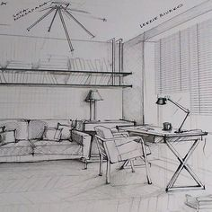
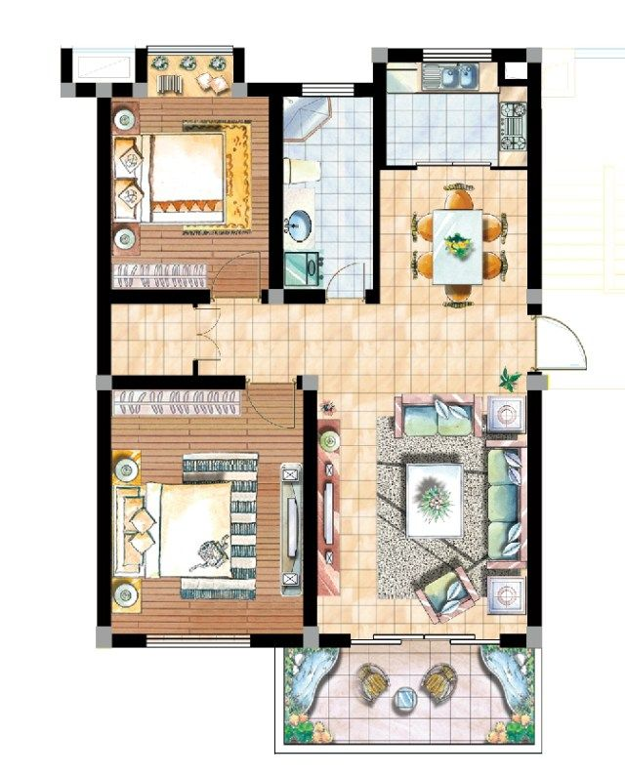
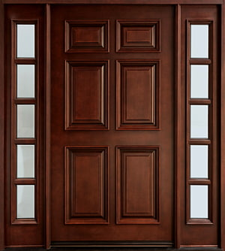
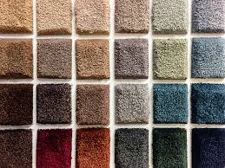
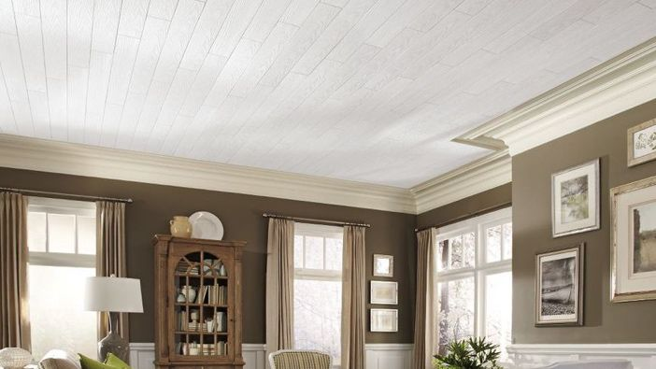
surface area
measurements
sketch
layout
CAN YOU THINK OF ANOTHER WORD USED TO DESCRIBE THE SIZE OF AN ITEM?
budget
carpet
samples
door frame
ceiling

Slide 5
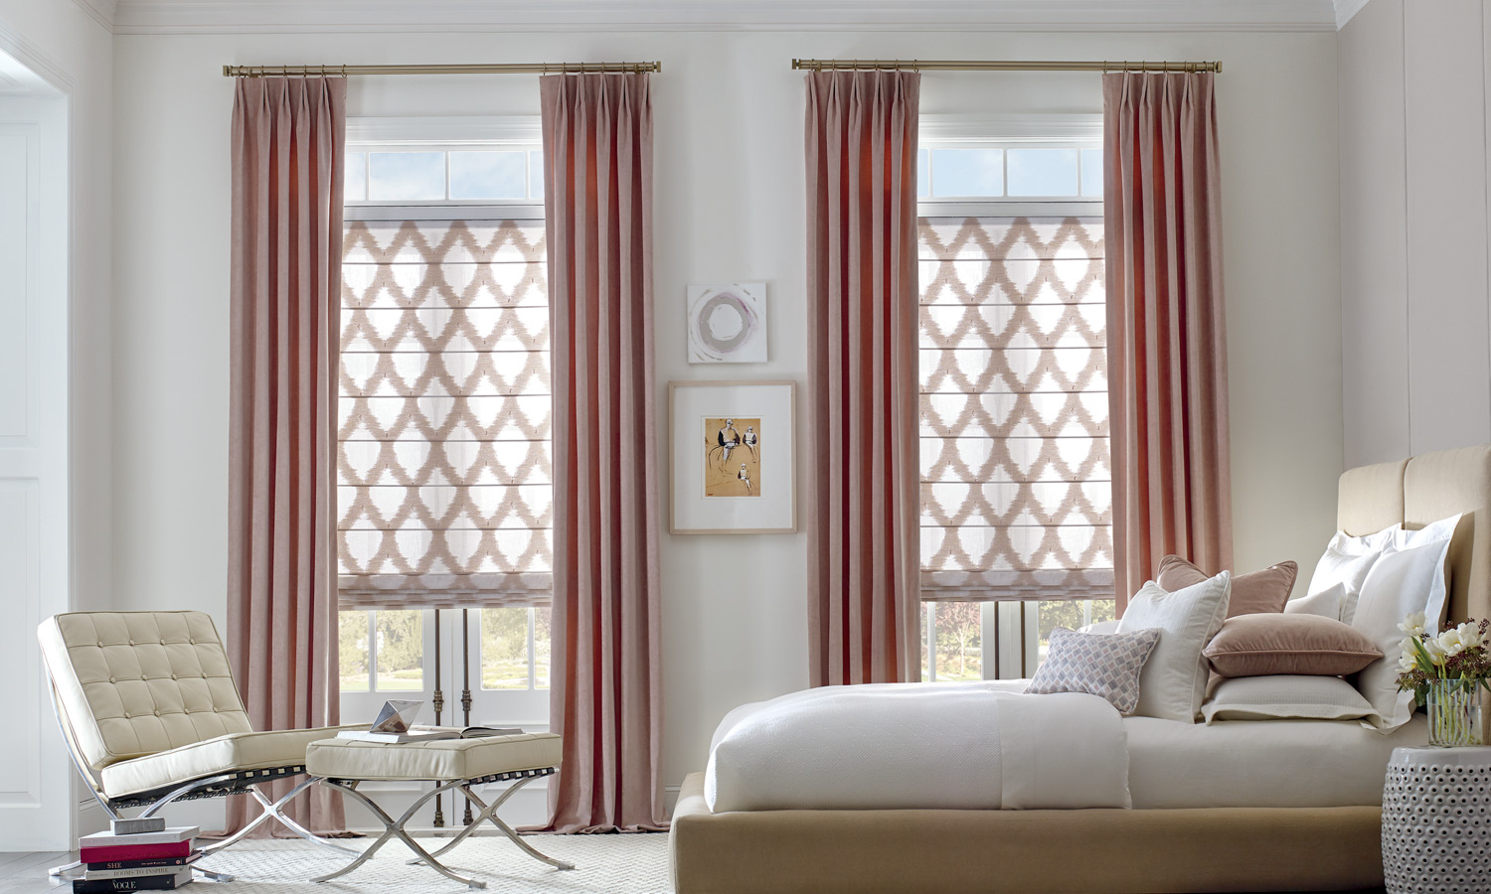
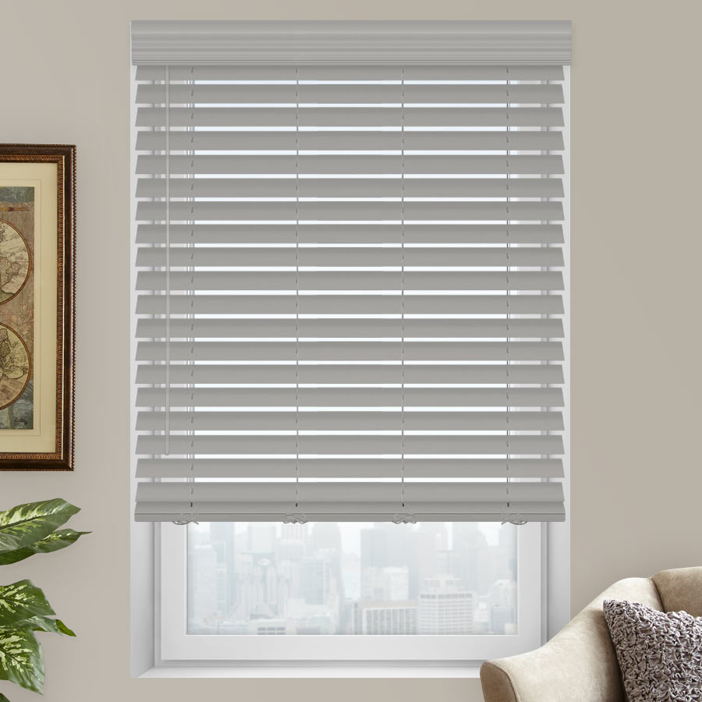
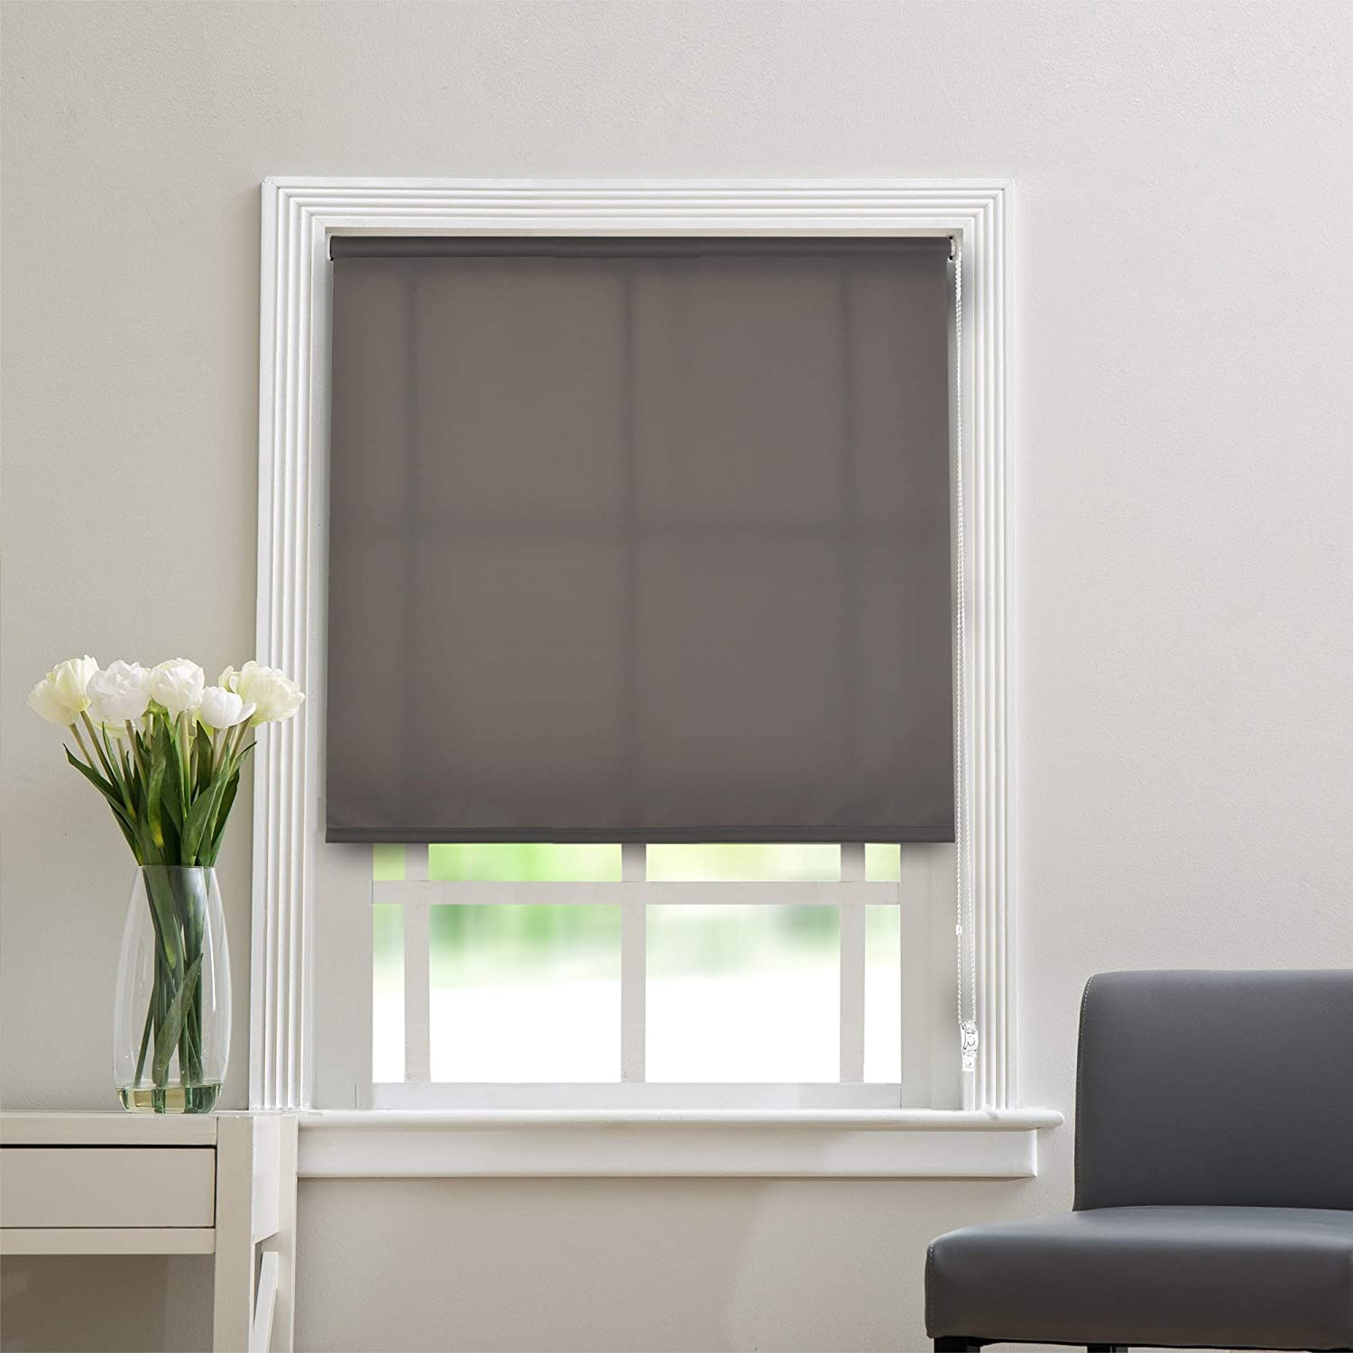
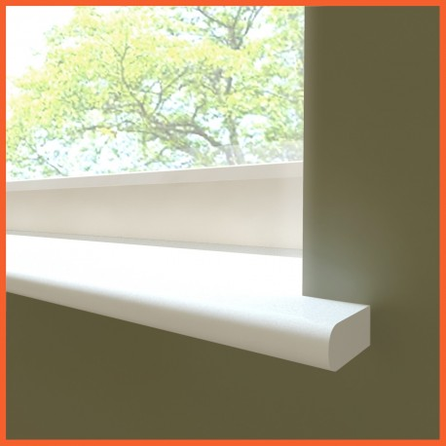
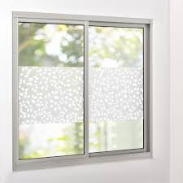
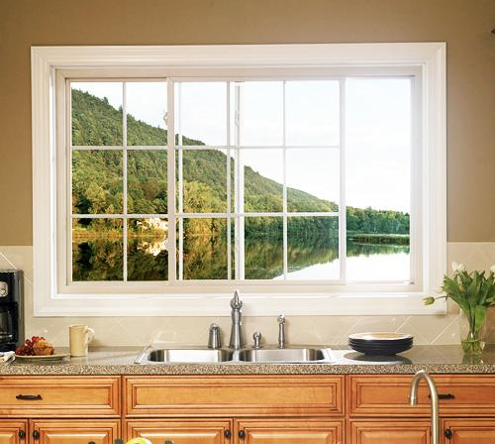
curtains/ window coverings
blinds
roller blinds
window sill
curtain rail/ rod
window foil
to hang
window frame
WHAT KIND OF WINDOW COVERING(S) DO YOU HAVE IN YOUR ROOM?

Slide 6
FEELING GOOD ABOUT THE VOCAB TEST?
Practice the vocabulary with this PP.
You can also go to Nearpod …..
You can find all documents and PPs in Teams – IA algemeen – IA documenten – S1P1 – Engels -
You will need to pass the vocab test + finish LLA online & Writing & Speaking in order to pass this period.
DEADLINES
Week 4 20-24 September | Week 8 25-29 October | Week 9 1-5 November
LLA ONLINE | VOCAB TEST | LLA WRITING & SPEAKING
On Nearpod, you can also find extra assignments* , for example: ‘Learn the names of more advanced colours.’ (*not required)

